Slide 1


Informatica Data Quality Key Generator , Duplicate Match and Associate Transformation

Slide 2
Task 1 : Create Physical Data Object ➔ DUPREC

Slide 3
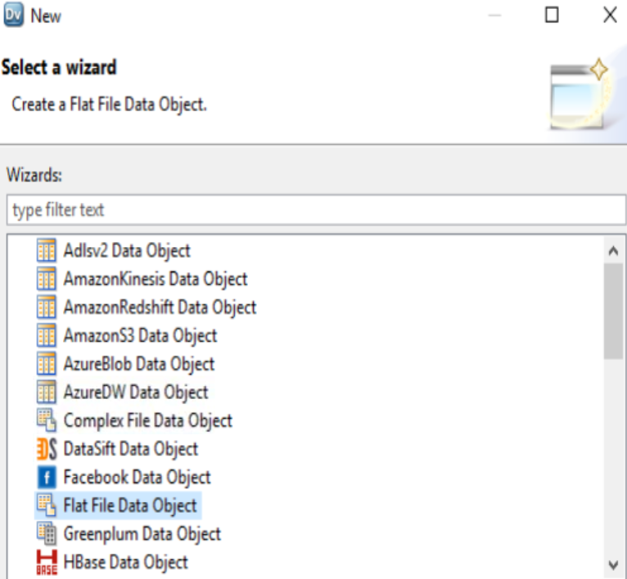
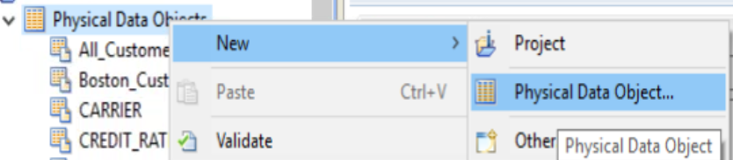
Step 1 : Create New Physical Data Objects
Name : duprec.CSV Delimited = Comma First Line Column Name => True Text Qualifier ➔ Double Quotes

Slide 4
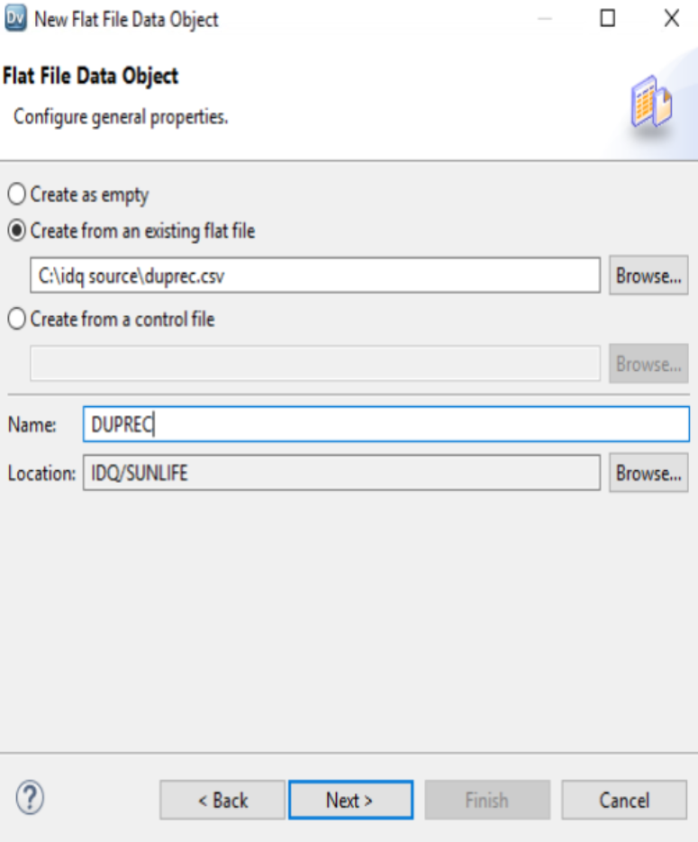
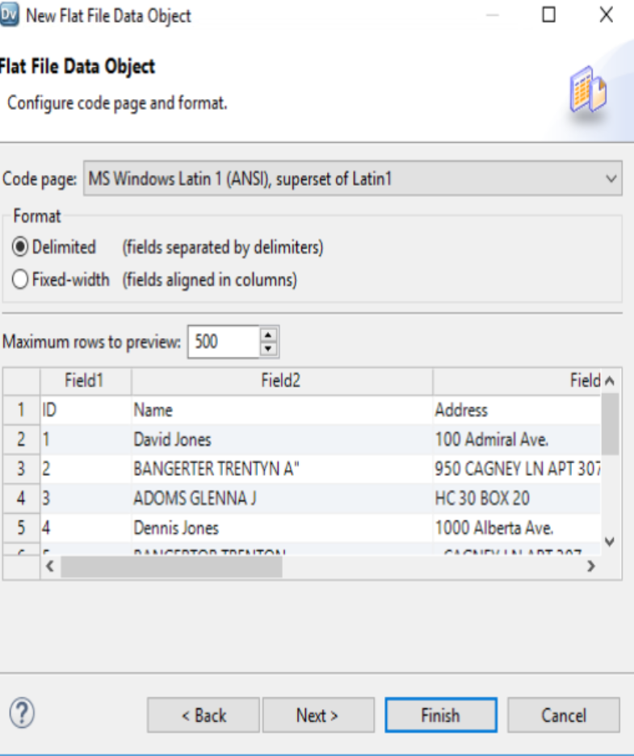
Step 1 : Create New Physical Data Objects
Name : duprec.CSV Delimited = Comma First Line Column Name => True Text Qualifier ➔ Double Quotes

Slide 5
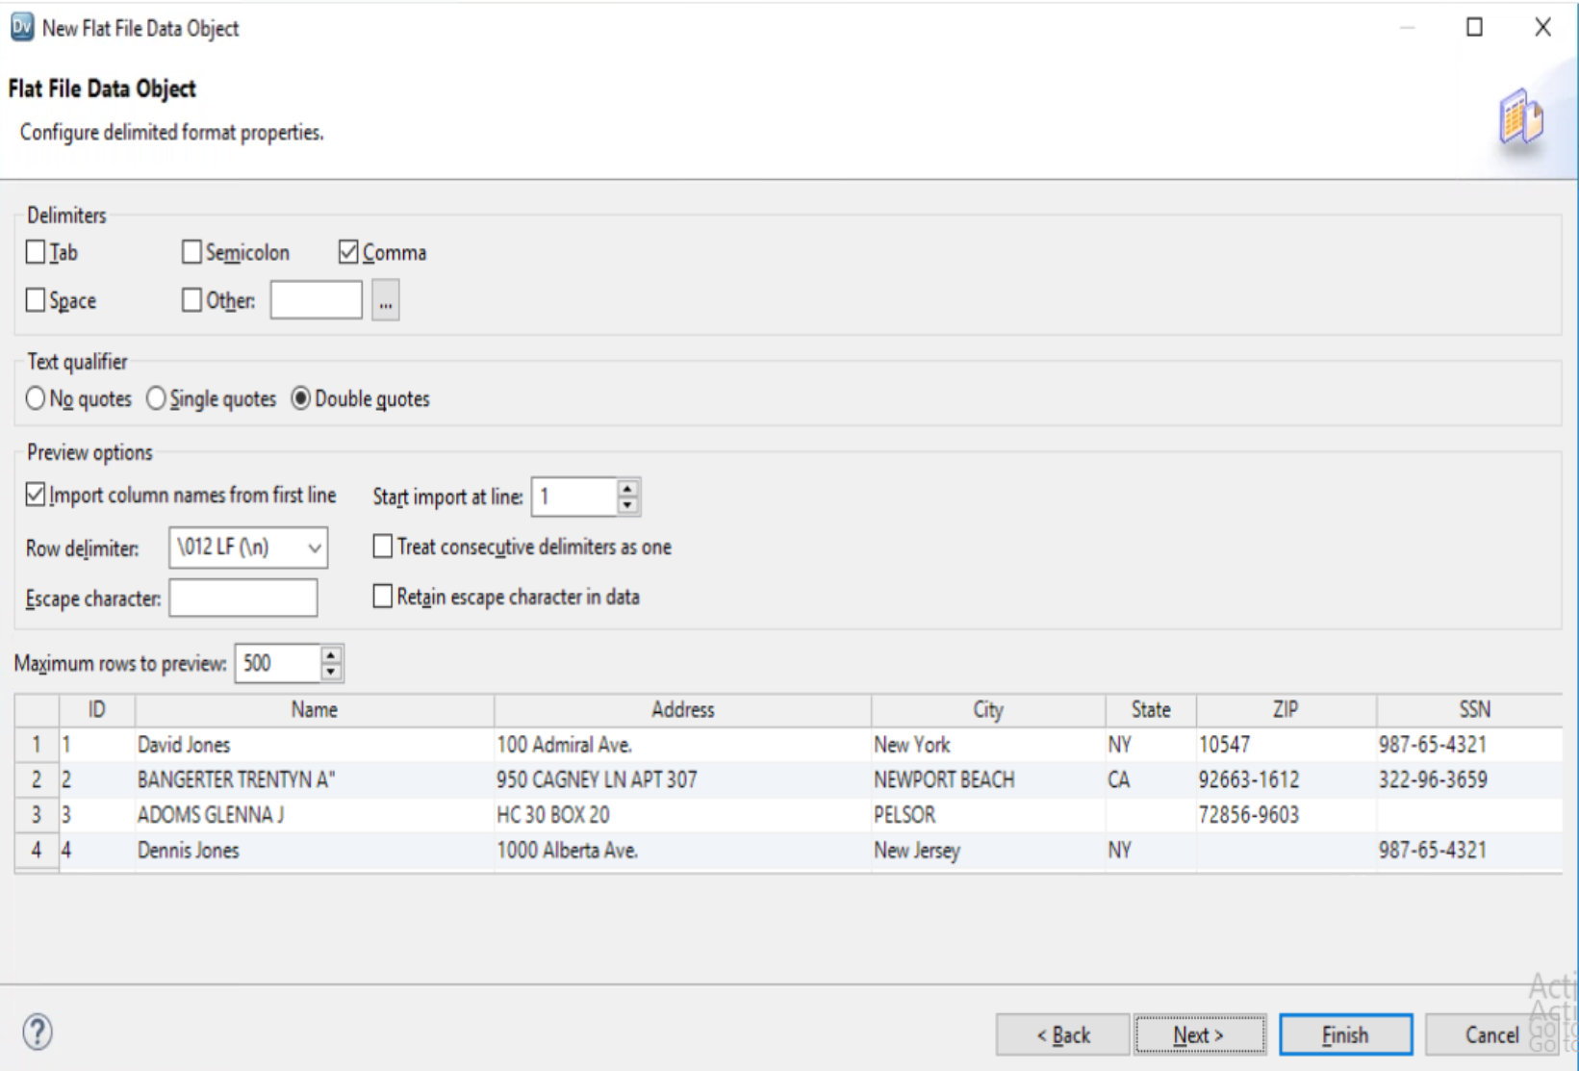
Step 1 : Create New Physical Data Objects
Name : duprec.CSV Delimited = Comma First Line Column Name => True Text Qualifier ➔ Double Quotes

Slide 6
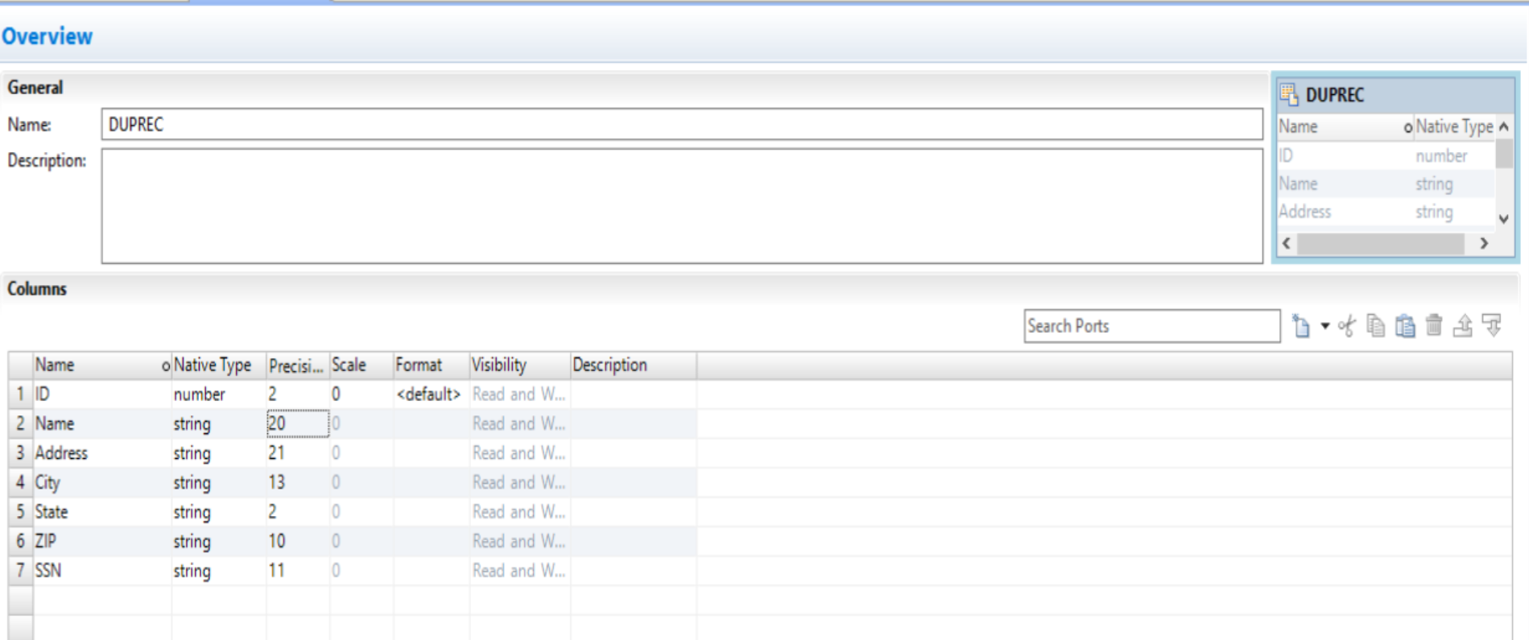
Step 1 : Create New Physical Data Objects
Name : duprec.CSV Delimited = Comma First Line Column Name => True Text Qualifier ➔ Double Quotes

Slide 7
Task 2 : Perform Data Profiling on Physical Data Object ➔ DUPREC

Slide 8
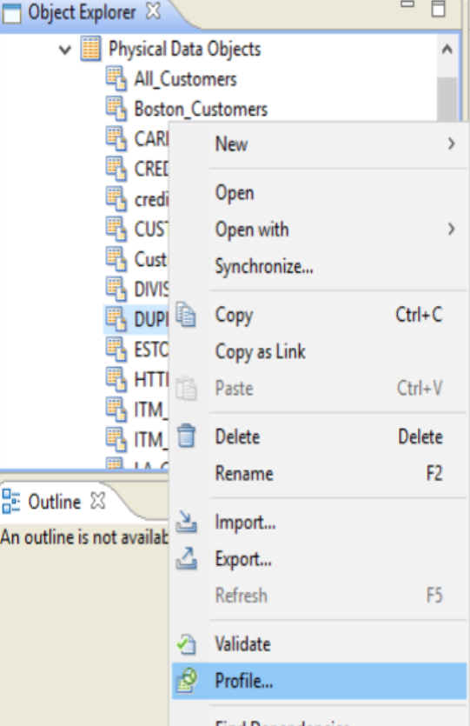
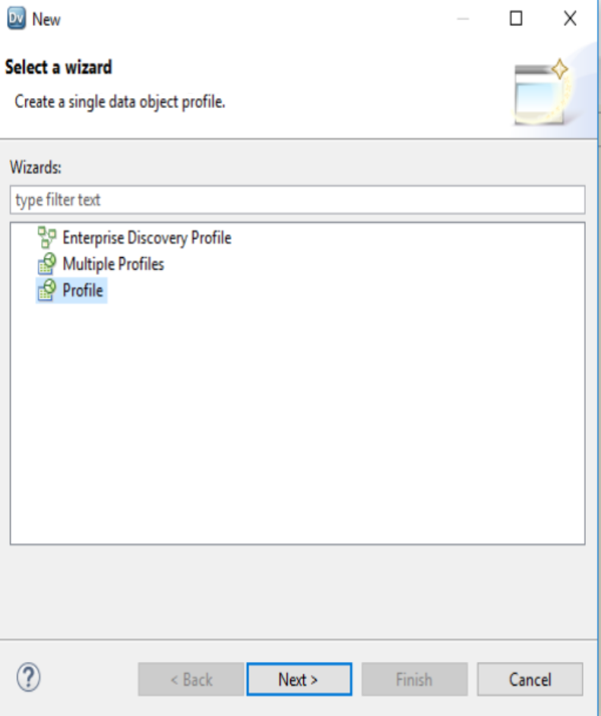
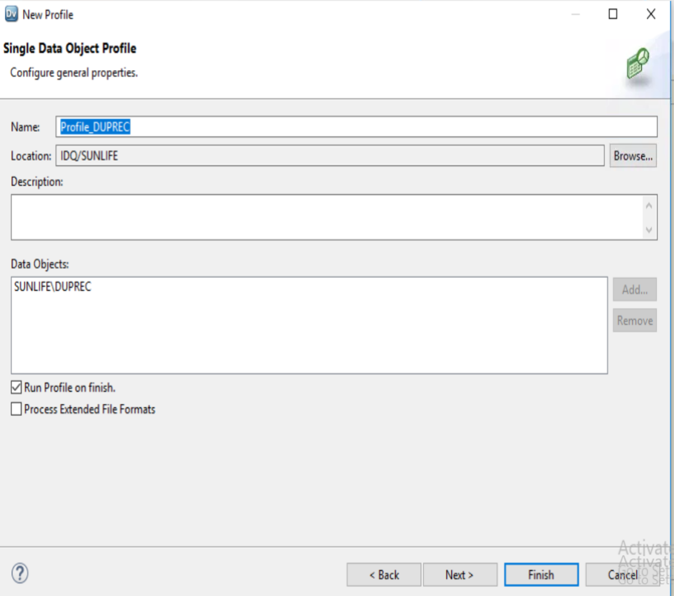
Step 2 : Perform Data Profiling ➔ DUPREC

Slide 9
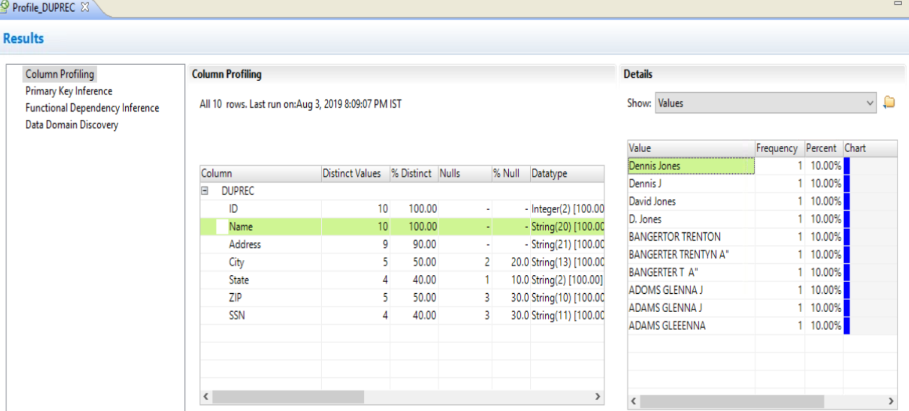
Step 2 : Analyze Data Profiling Result ➔ DUPREC and Analyze Column , Name, Address,city,state,zip and SSN

Slide 10
Task 3: Grouping Data

Slide 17
Task 3 A : Create New Mapping for Duplicate Elimination

Slide 18
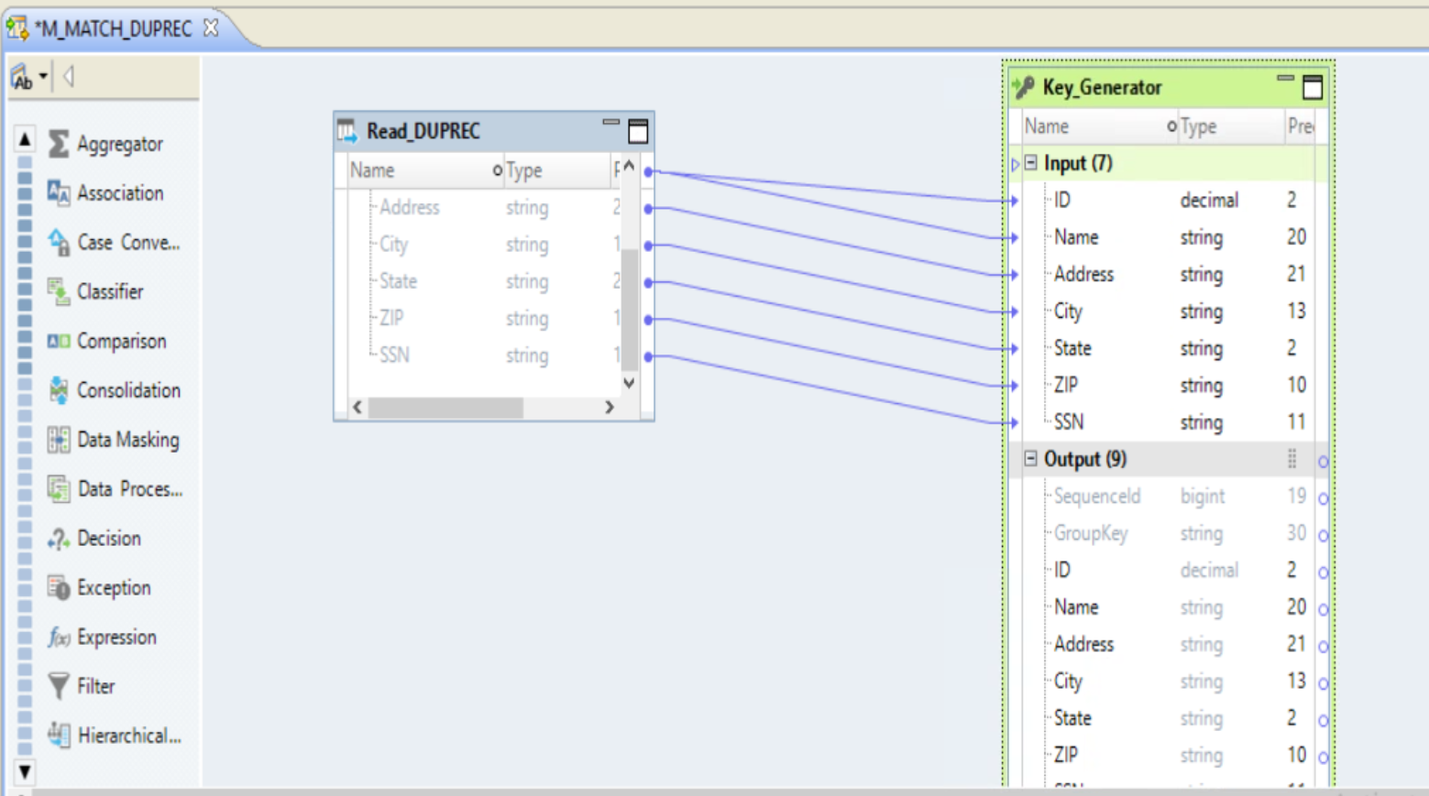
Step 3 : Create New Mapping ➔ M_MATCH_DUPREC
A . ADD SOURCE ➔ DUPREC(read)
Add Transformation (KEY GENERATOR)
Drag ALL Column to INPUT for KEY GENERATOR

Slide 19
Task 3B : Key Generator Transformation

Slide 20
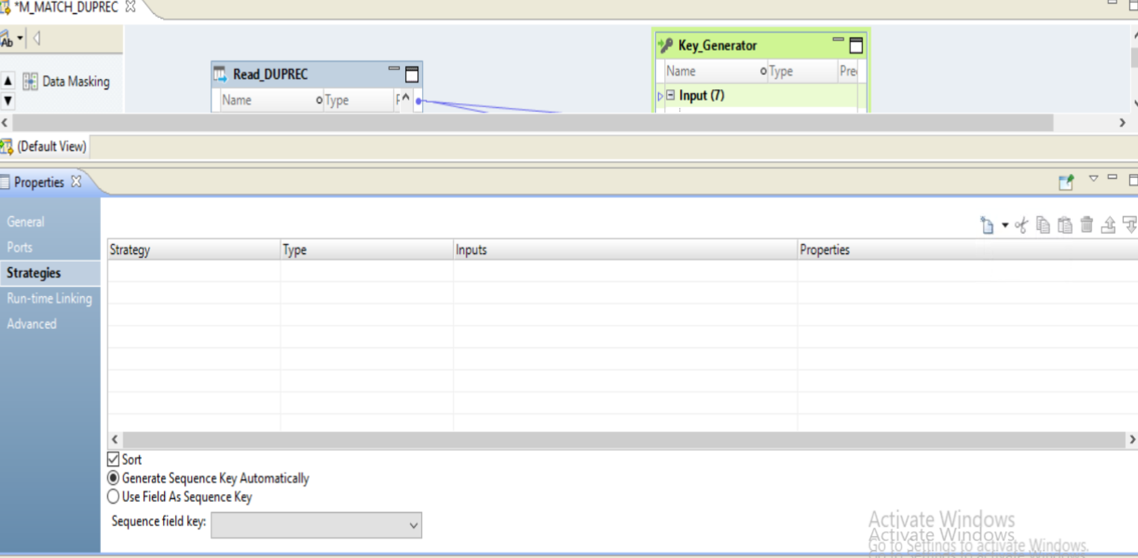
Step 4 : KEY GENERATOR Transformation
A . Choose Key GENERATOR Transformation ➔ Properties

Slide 21
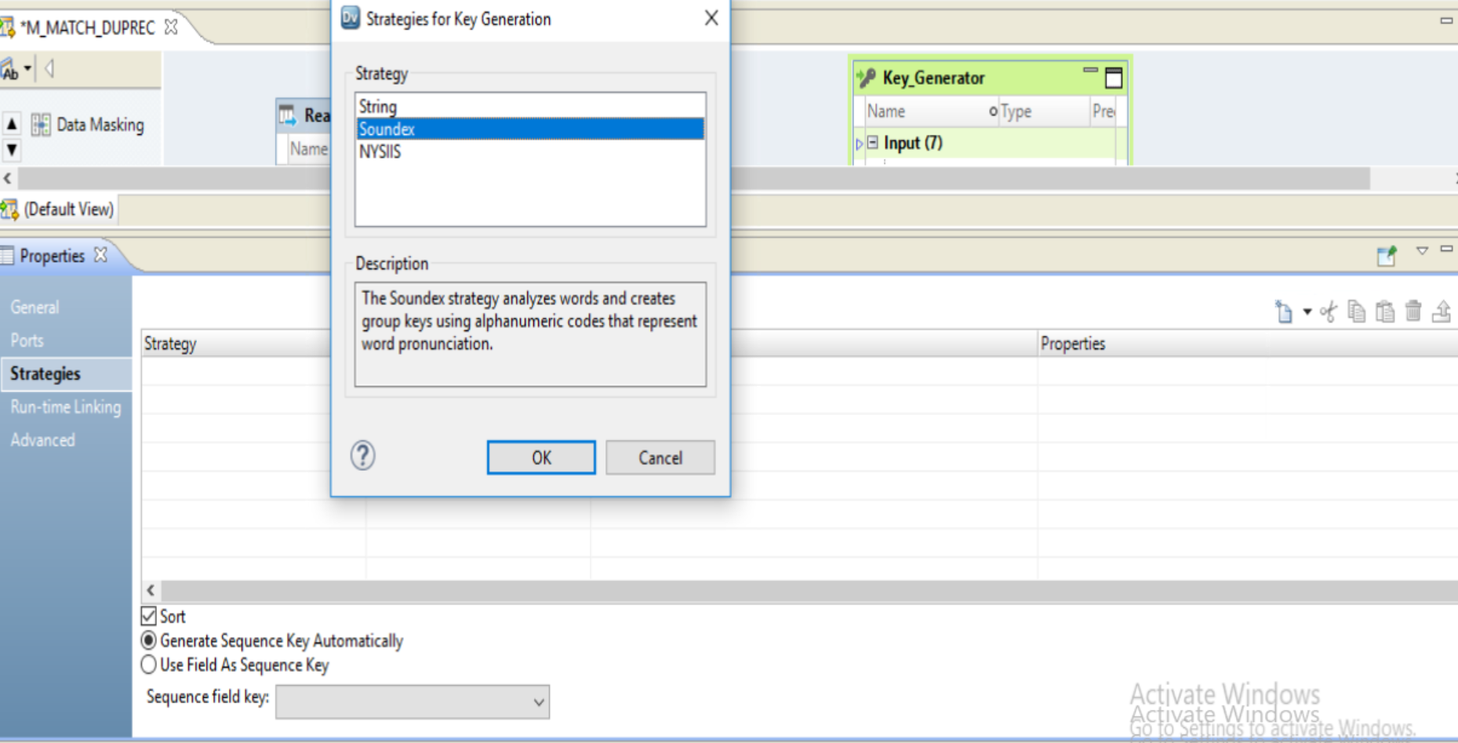
Step 4 : Key Generator Transformation
A . Create New Strategies ➔ SOUNDEX

Slide 22
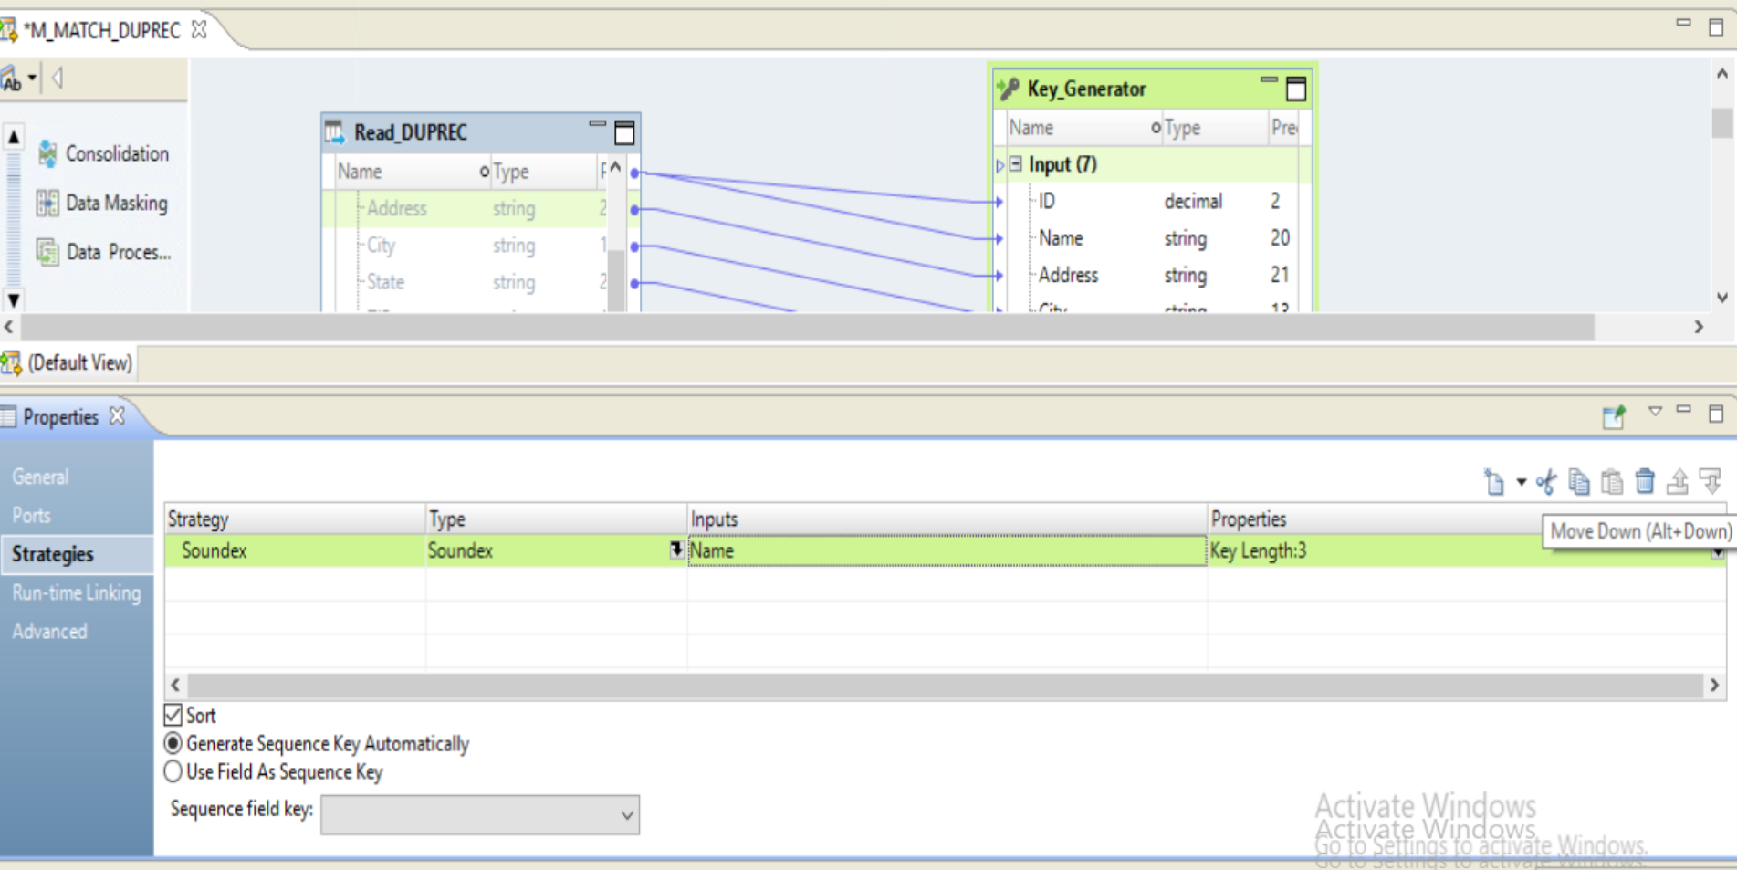
Step 4 : KEY GENERATOR TRANSFORMATION
A . Choose New Strategy ➔ SOUNDSEX ➔ INPUT ➔ NAME Column

Slide 23
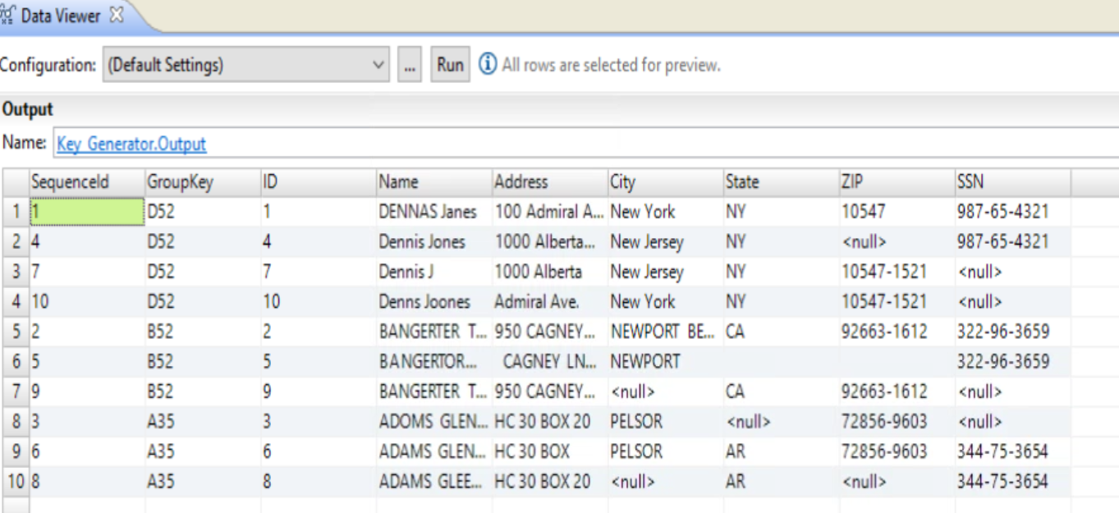
Step 4 : KEY GENERATOR Transformation
A . RUN DATA VIEWER
B . Check GROUP Key

Slide 24
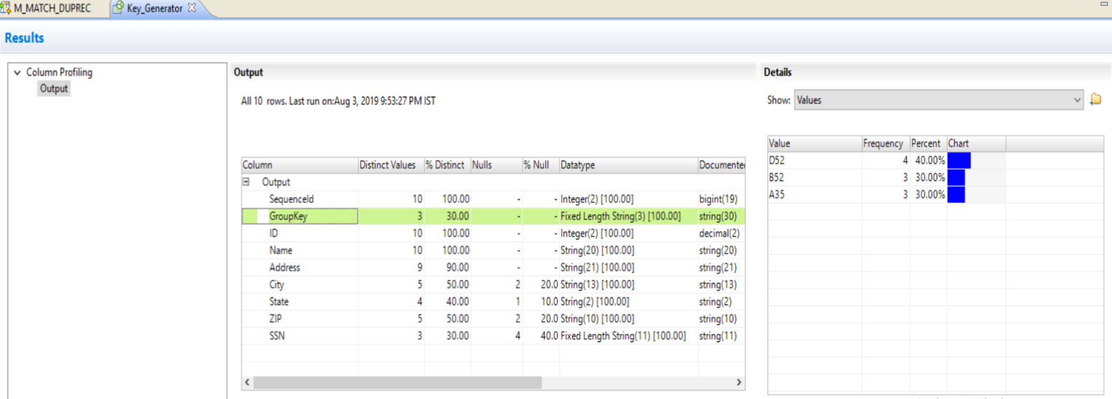
Step 4 : KEY GENERATOR Transformation
A . RUN DATA PROFILE

Slide 25
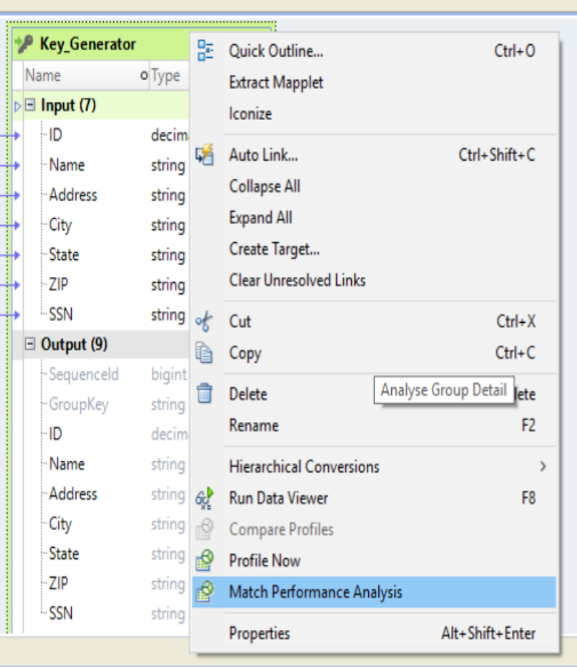
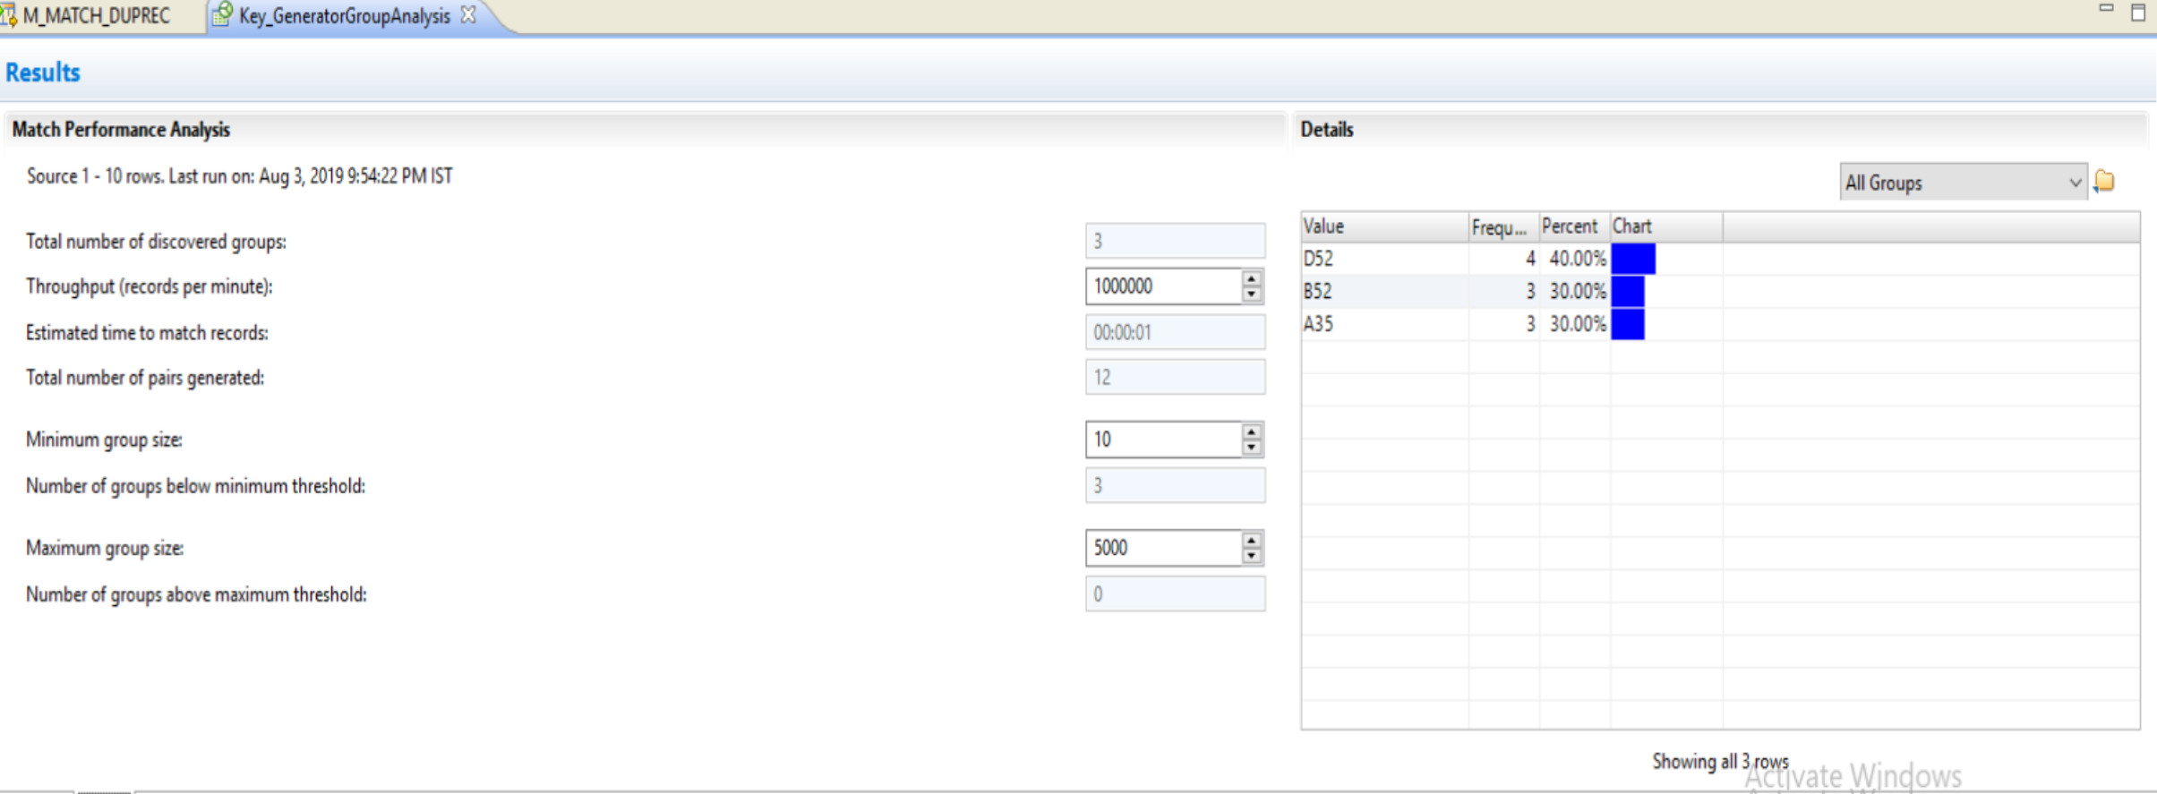
Step 4 : KEY GENERATOR Transformation
A . MATCH PERFORMANCE Analysis

Slide 26
Task 5 : Match Transformation

Slide 27
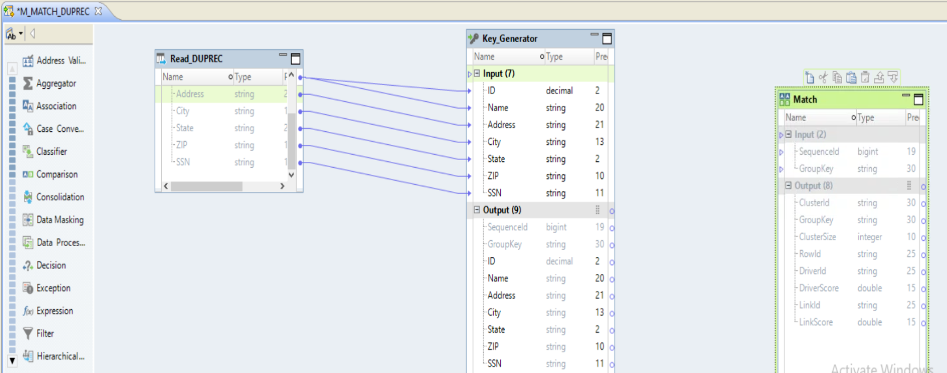
Step 5: MATCH Transformation
A . ADD MATCH TRANSFORMATION

Slide 28
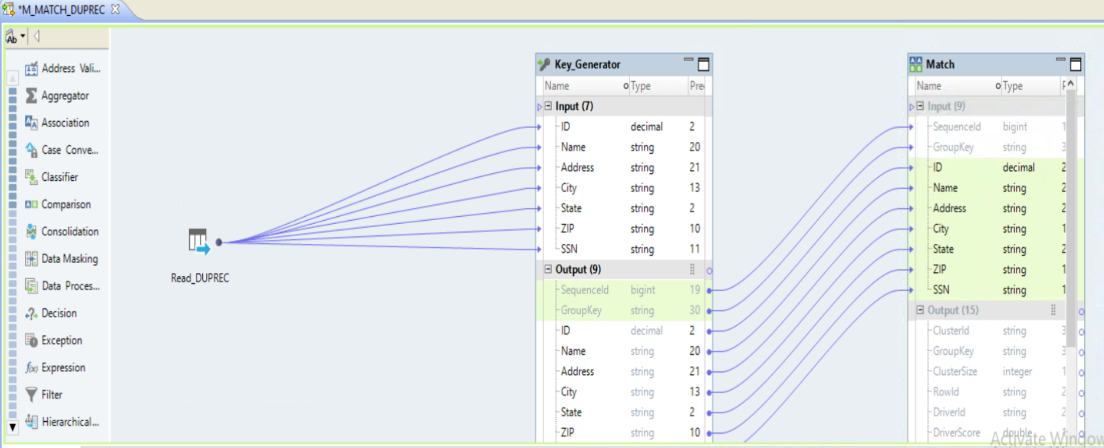
Step 5: MATCH Transformation
A . DRAG all Column from KEY GENERATOR ➔ ouput ➔ INPUT OF Match Transforamtion

Slide 29
Task 5a : Match Transformation – Pair Generation

Slide 32
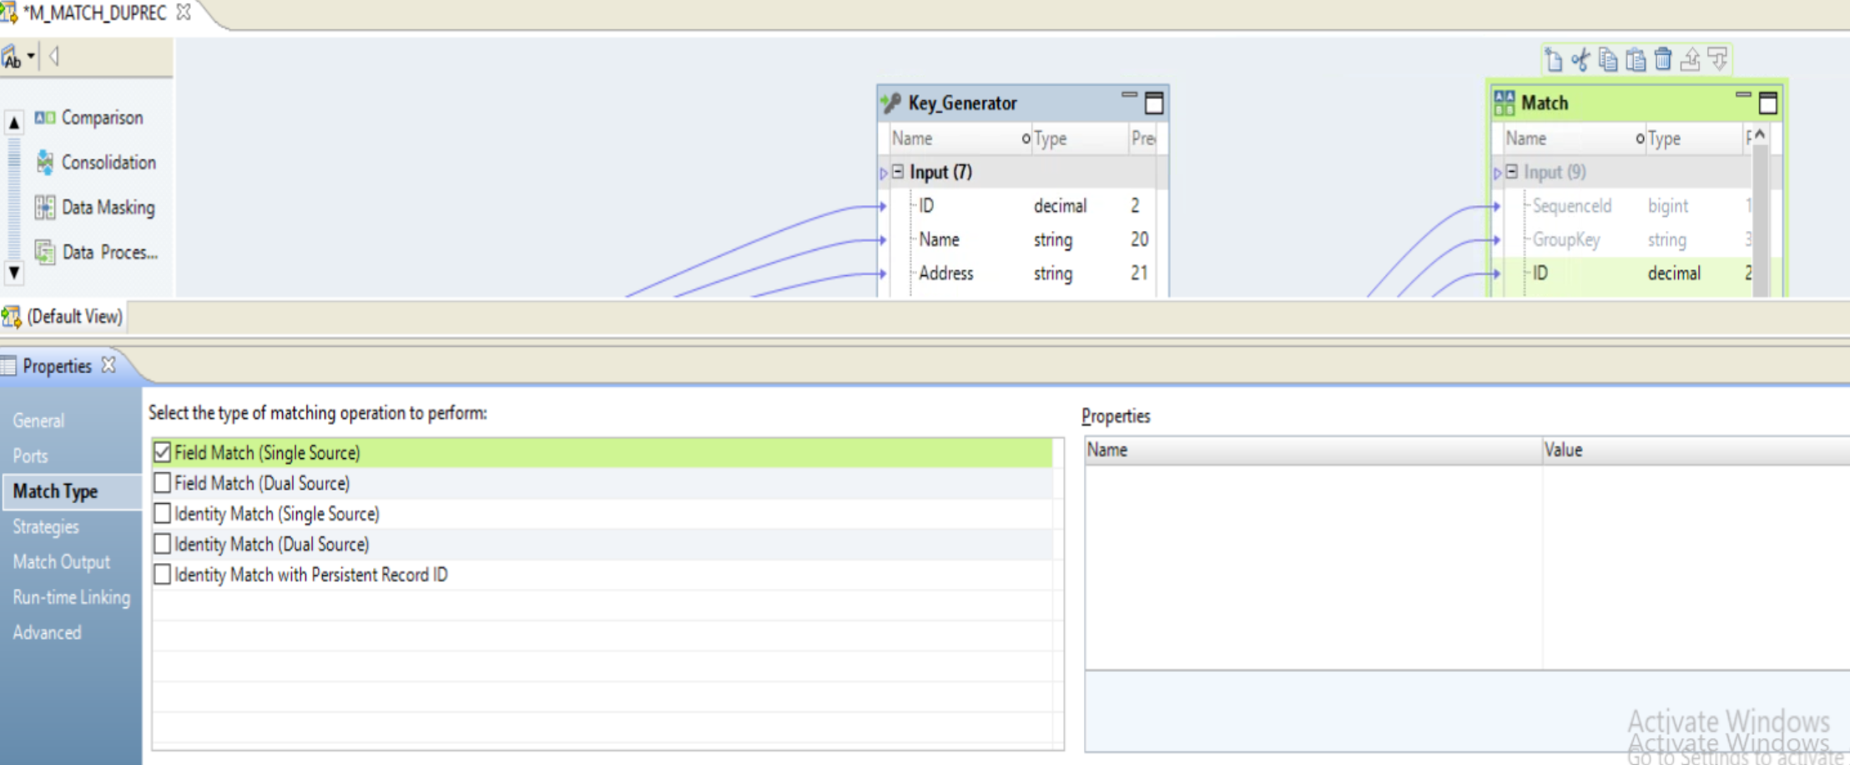
Step 5: MATCH Transformation
A . MATCH Transformation ➔ Properties ➔ Match Type ➔ Field Match ( Single Source )

Slide 33
TASK 5B: Match Transformation – Scoring Match Strategies

Slide 37
Edit Distance:
Use the Edit Distance strategy to compare words or short text strings, such as names.
Edit Distance Example : Levenston Levenshtein
The Edit Distance algorithm divides the number of unchanged characters (8) by the length of the longest string (11). In this example, the strings are 72.7% similar and the match score is 0.727

Slide 39
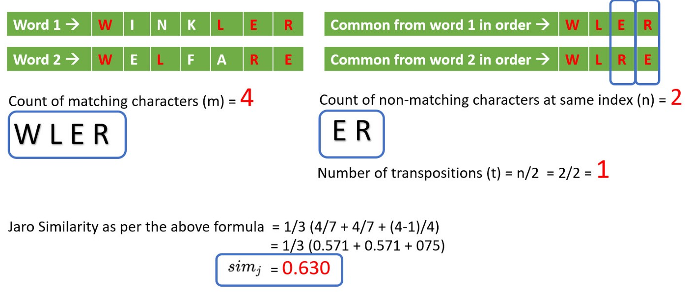
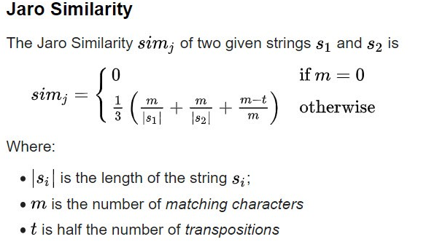

Slide 40
Jaro Distance: Use the Jaro Distance strategy to compare two strings when the similarity of the initial characters in the strings is a priority.
Penalty Determines the match score penalty if the first four characters in two compared strings are not identical.
The transformation subtracts the full penalty value for a first-character mismatch. The transformation subtracts fractions of the penalty based on the position of the other mismatched characters. The default penalty value is 0.20.
Jaro Distance Example Consider the following strings: ¨ 391859 ¨ 813995
If you use the default Penalty value of 0.20 to analyze these strings, the Jaro Distance strategy returns a match score of 0.513. This match score indicates that the strings are 51.3% similar.

Slide 41
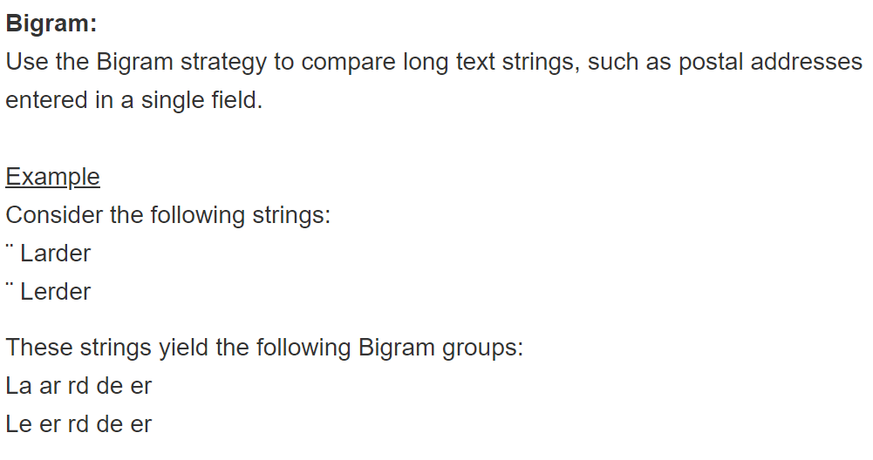

Slide 42
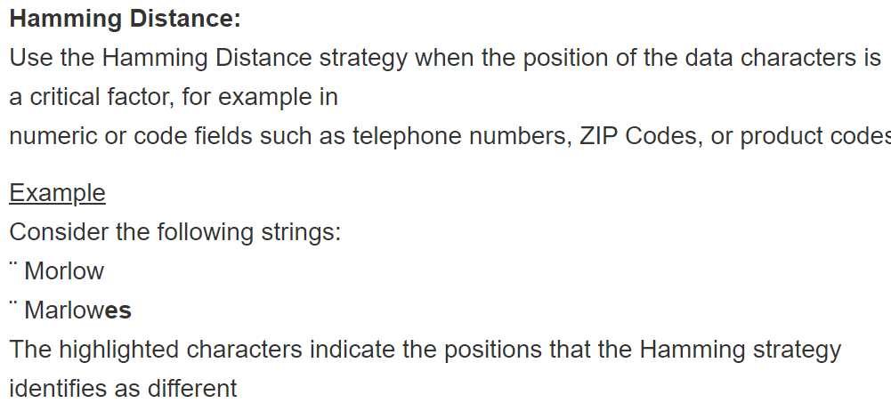

Slide 43
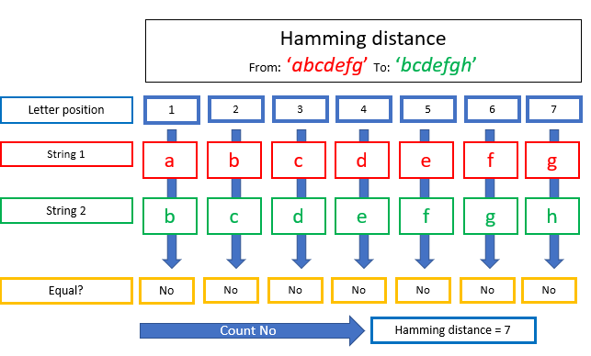
An advantage of the Hamming Distance is that it is very fast and simple to do this position-wise comparison.
On the other hand, critics are that it cannot take into account two strings with an unequal number of letters.
Another critic is that it is too strict, for example, “abcdefg” and “bcdefgh” are considered totally different, while 6 out of 7 characters are the same.
To compute the Hamming distance between two strings, you compare the characters of each position in the string. The number of unequal characters is the Hamming distance.

Slide 45
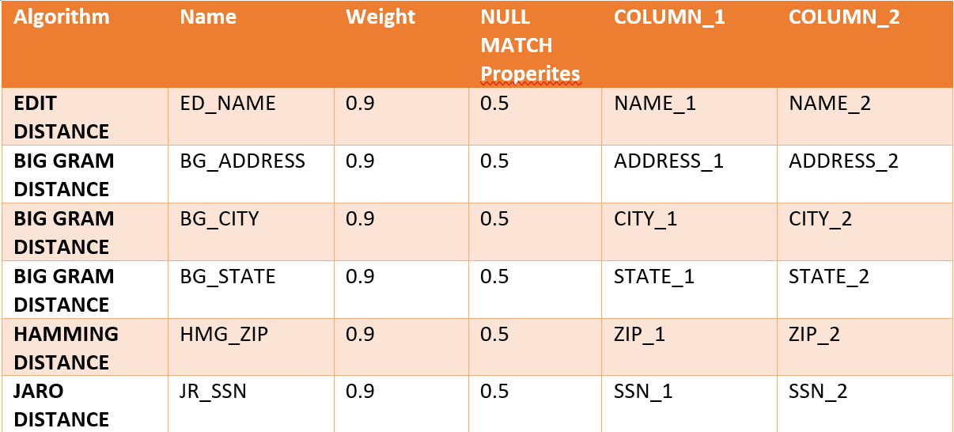
Step 5: MATCH Transformation
A Strategies ➔ Algorithm

Slide 46
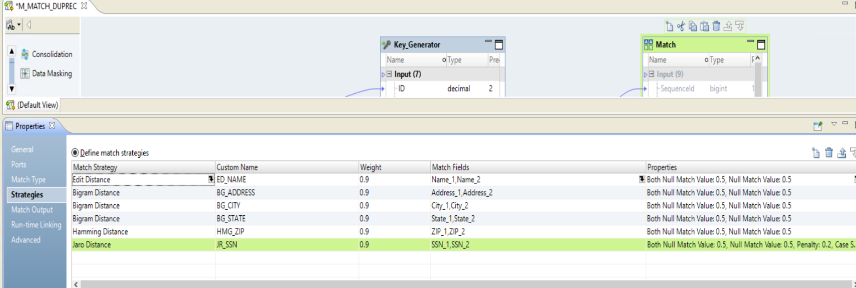
Step 5: MATCH Transformation
A . STRATEGIES

Slide 47
TASK 5C: Match Transformation – Processing Match Output

Slide 50
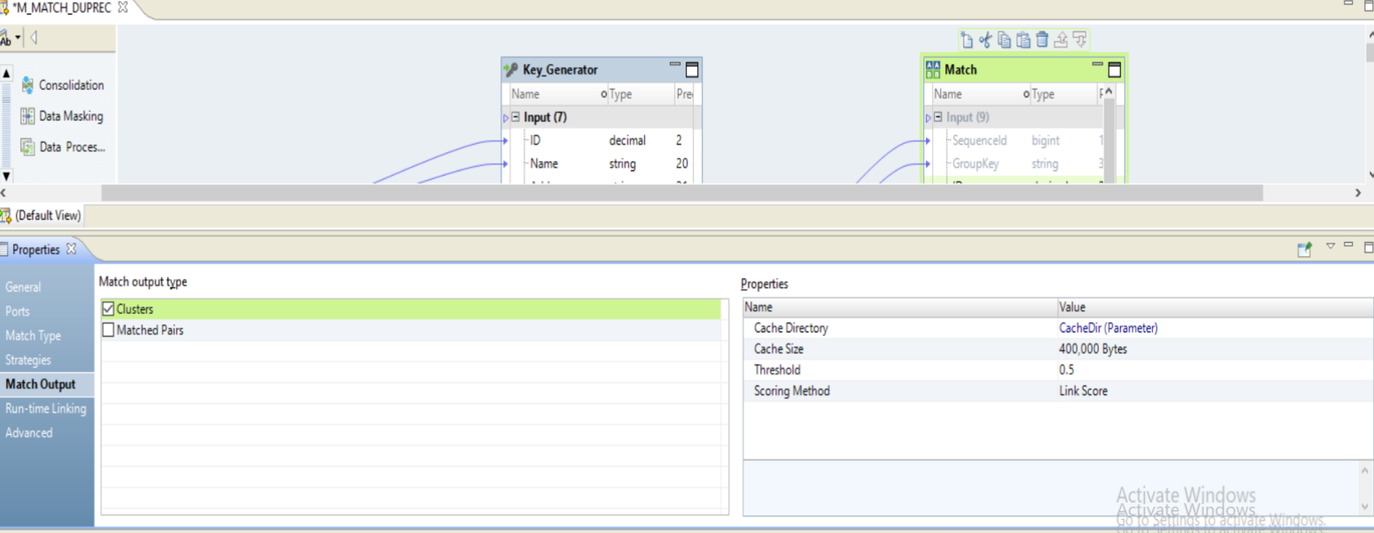
Step 5: MATCH Transformation
A . MATCH OUTPUT ➔ THRESHOLD ➔ 0.5

Slide 51
TASK 5D: Match Transformation – RUN DATA VIEWER

Slide 52
Step 5: MATCH Transformation
A . RUN DATA VIEWER

Slide 53
Step 5: MATCH Transformation

Slide 54
Step 5: MATCH Transformation

Slide 55
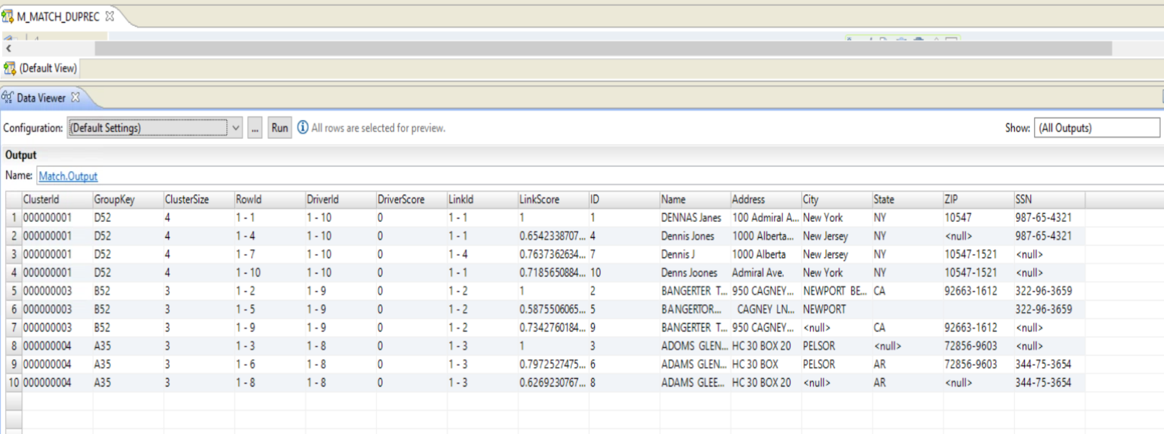
Step 5: MATCH Transformation
A . RUN DATA VIEWER

Slide 56
TASK 5E: DATA PROFILE ON MATCH Transformation

Slide 57
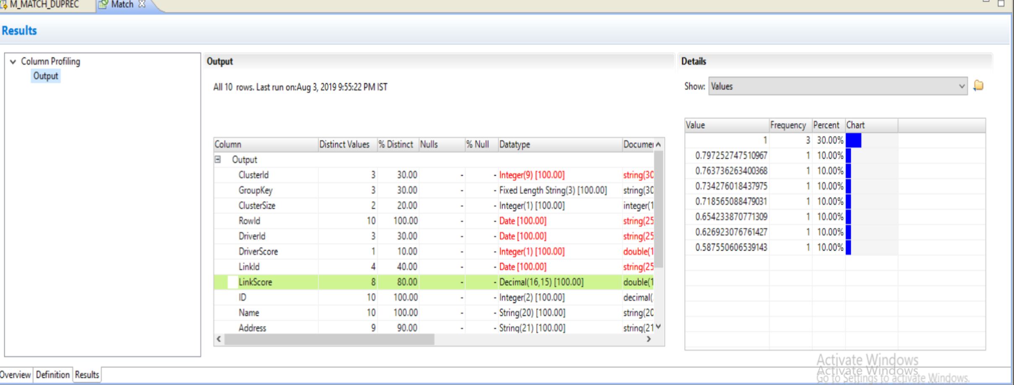
Step 5: MATCH Transformation
A . RUN DATA Profile ON match Transforamtion

Slide 58
TASK 5F: MATCH CLUSTER Analysis

Slide 59
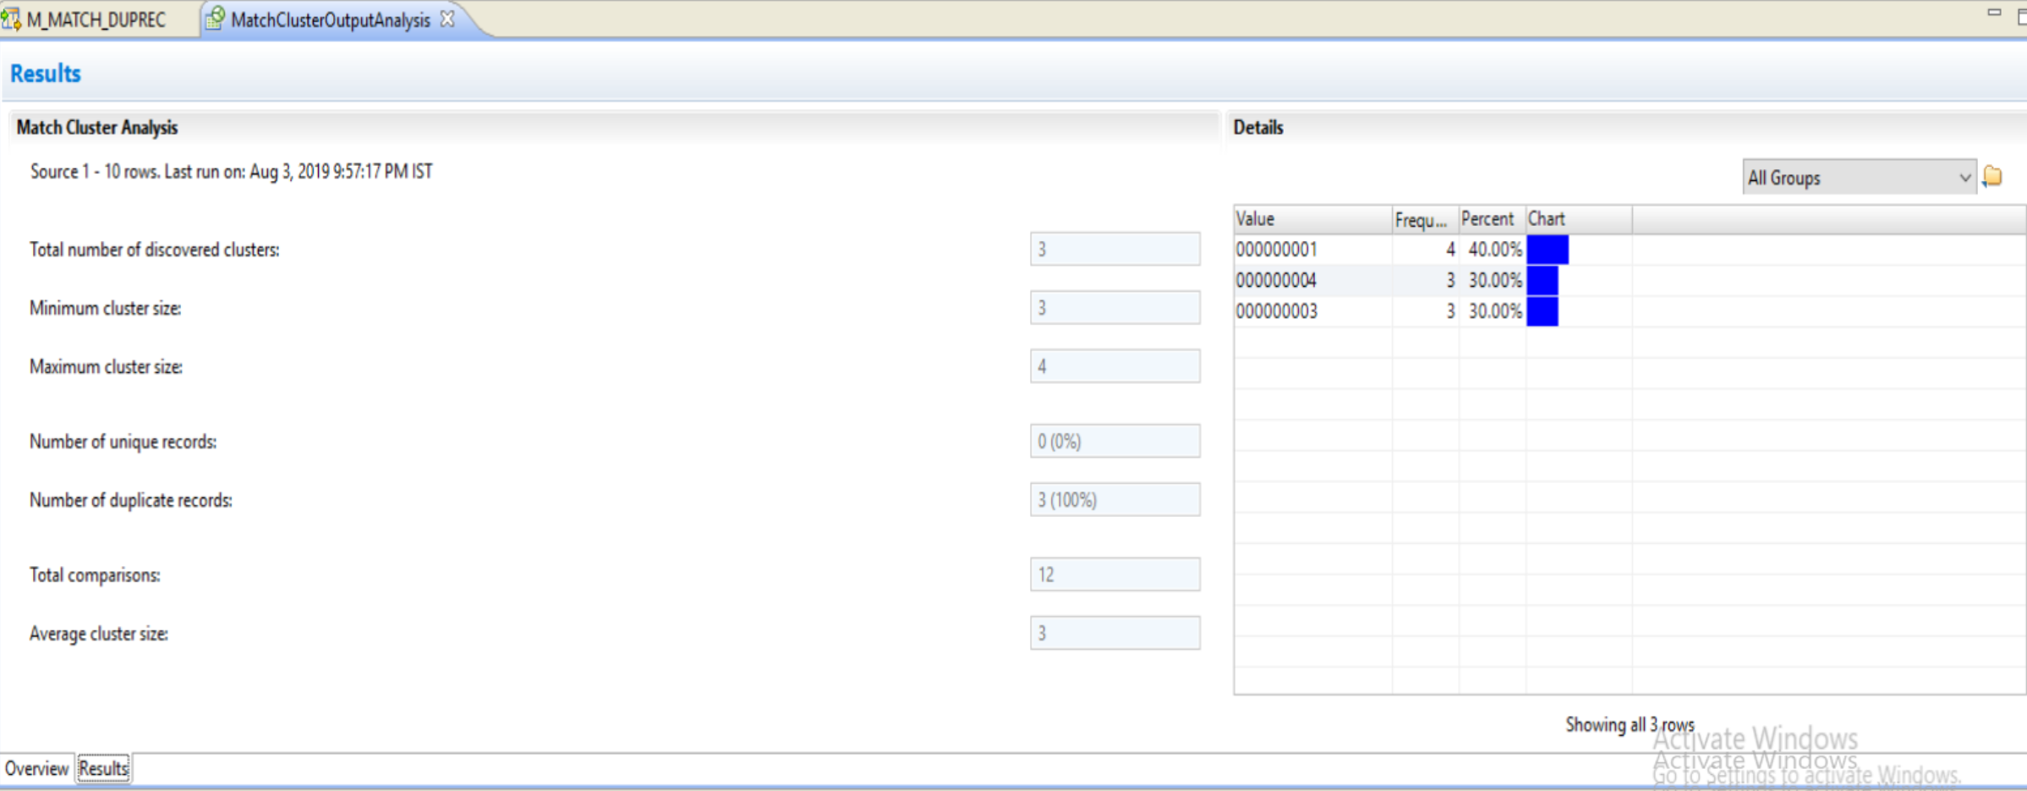
Step 5: MATCH Transformation
A . RUN MATCH CLUSTER ANALYSIS

Slide 60
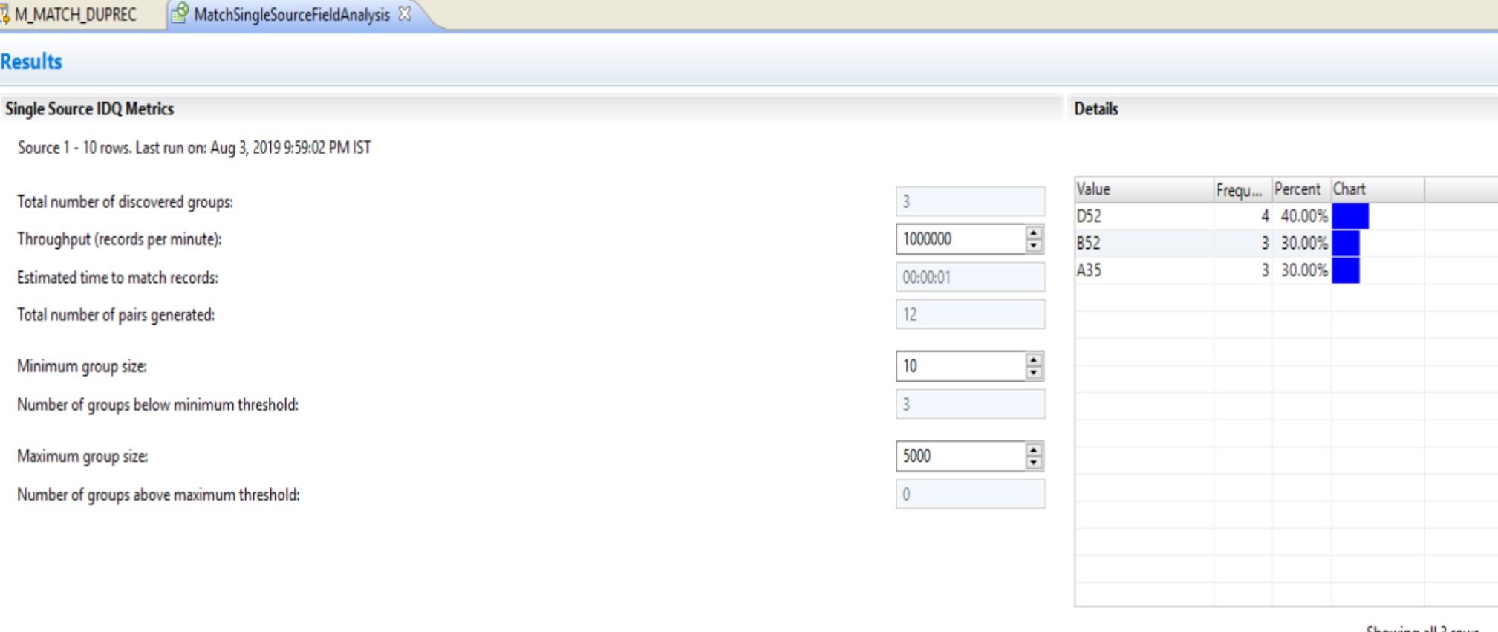
Step 5: MATCH Transformation
A . MATCH PERFORMANCE ANALYSIS

Slide 61
Task 6 : Association Transformation

Slide 64
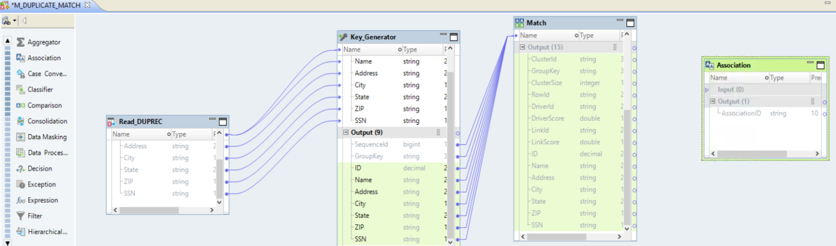
Step 6: Association Transformation
A . Add New Transforamtion ➔ Association

Slide 65
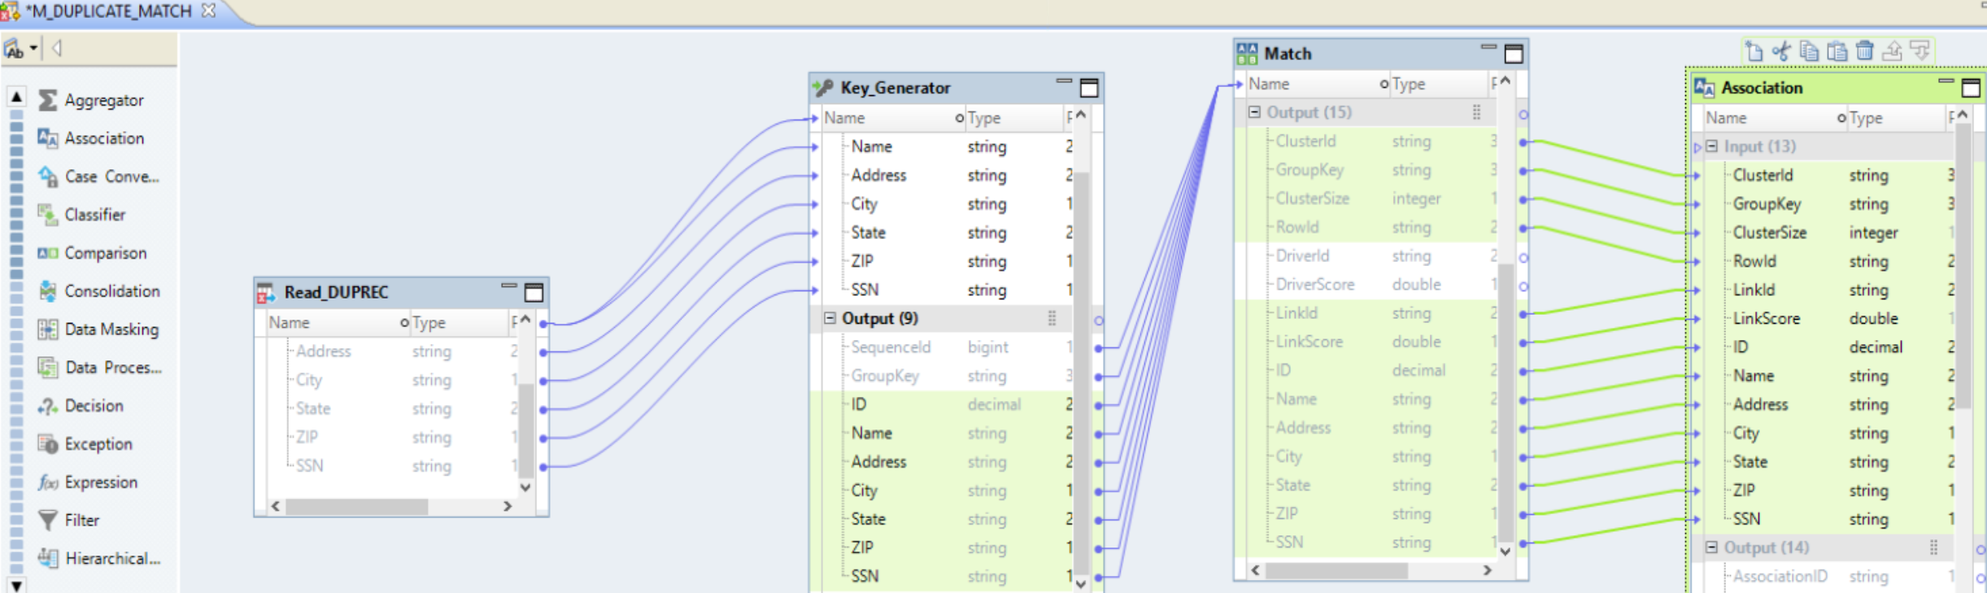
Step 6: Association Transformation
A . Drag all Port from Match Transformation to Association Transformation Except Driverid, DriverScore

Slide 66
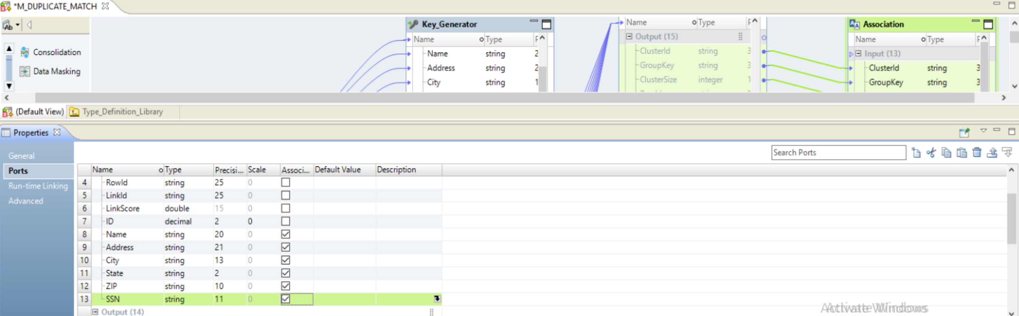
Step 6: Configure Association Transformation
Associate Transformation Ports ➔ Name, Address, City,state,zip,SSN

Slide 67
Task 6 : Run Data Viewer ➔ Associate Transforamtion

Slide 68
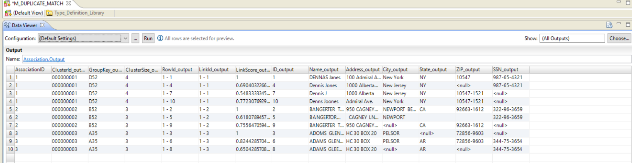

Slide 69
Task 7 : Consolidation Transformation

Slide 72
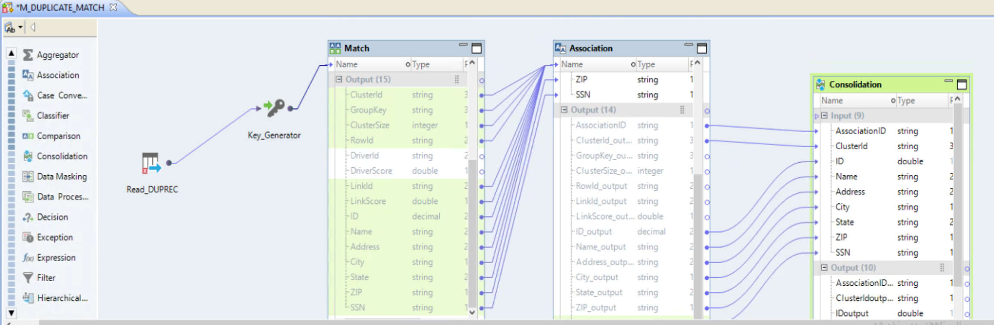
Step 7: CONSOLIDATION Transformation
A . Add New Transformation ➔ Consolidation
A . Link ASSOCIATION ID , CLUSTERID, ID NAME, ADDRESS, CITY, STATE , ZIP , SSN to INPUT

Slide 73
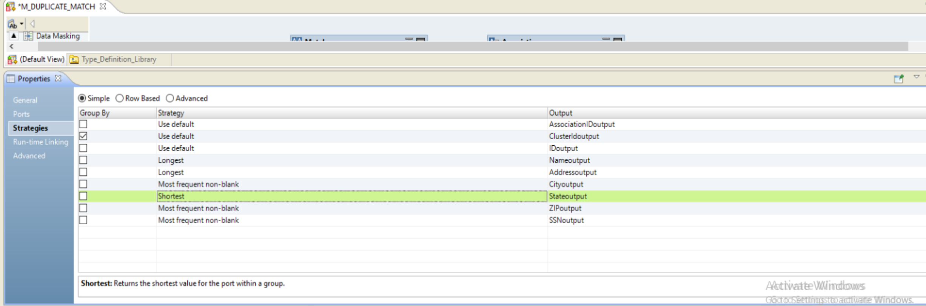
Step 7: CONSOLIDATION Transformation
A . CONSOLIDATION TRANSFORMATION ➔ PROPERTIES ➔ STRATEGIES
GROUP BY ➔ CLUSTERID
STRATEGIES BELOW

Slide 74
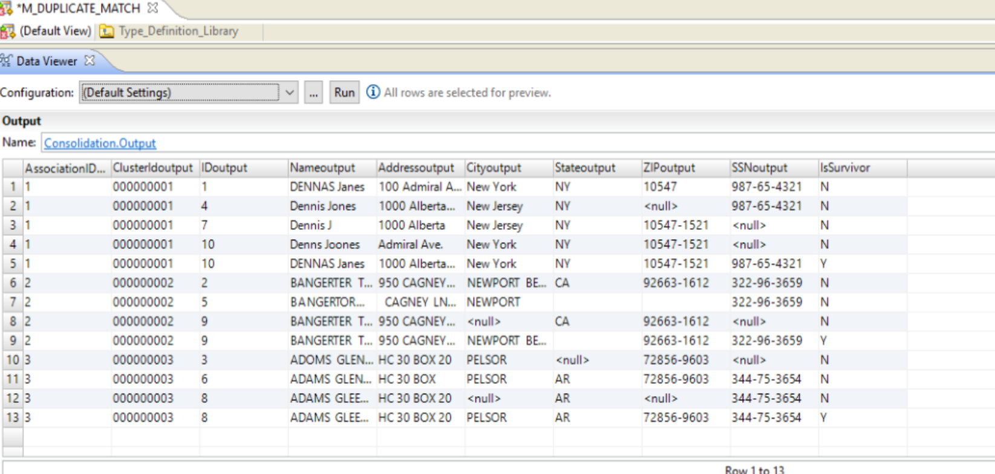
Step 7: CONSOLIDATION Transformation
A . RUN DATA VIEWER
ISSURVIVOR RECORD

Slide 75
Task 7 : FILTER Transformation

Slide 76
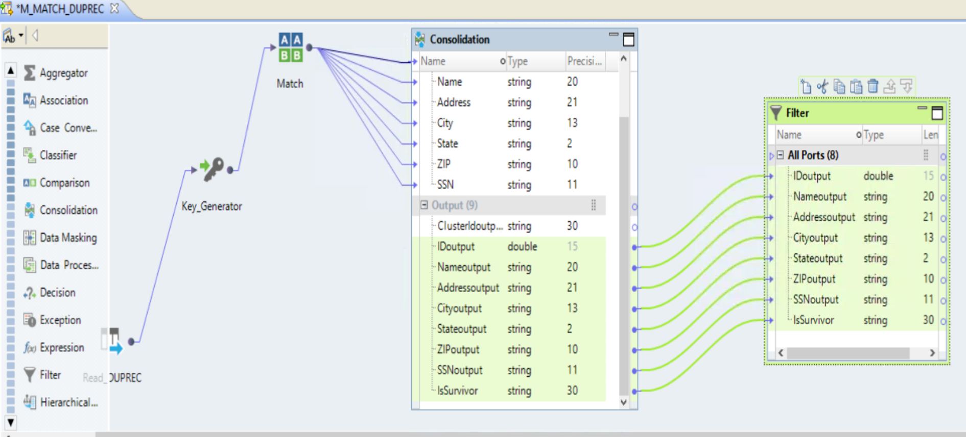
Step 7: FILTER Transformation
A . ADD FILTER TRANSFORAMTION AND FILTER RECORDS ONLY IF IsSurvivor =Y

Slide 77
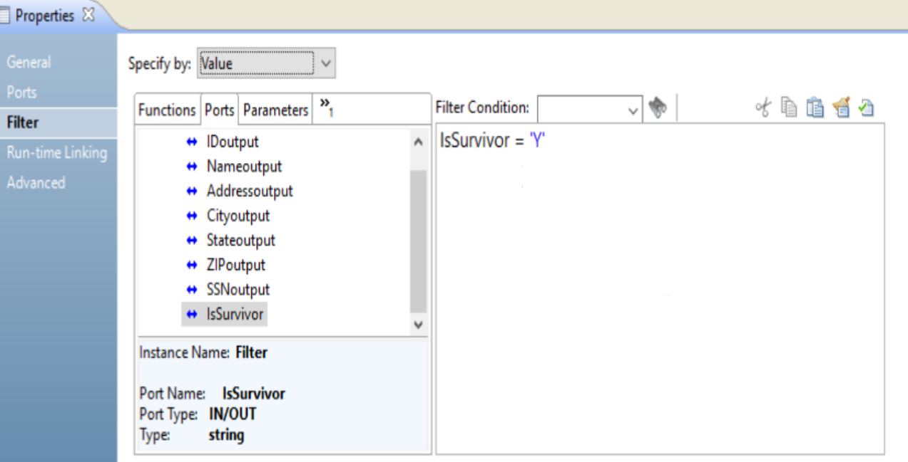
Step 7 FILTER Transformation
A . ADD FILTER TRANSFORAMTION CONDITION IsSurvivor =Y

Slide 78
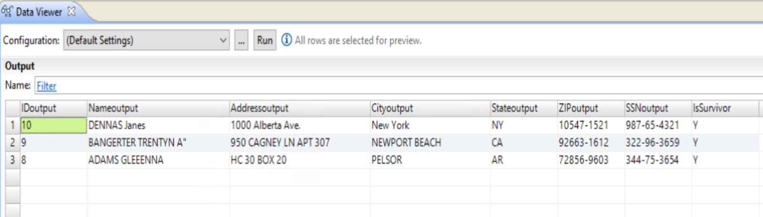
Step 7: FILTER Transformation
A . RUN DATA VIEWER

Slide 79
Task 8 : TARGET

Slide 80
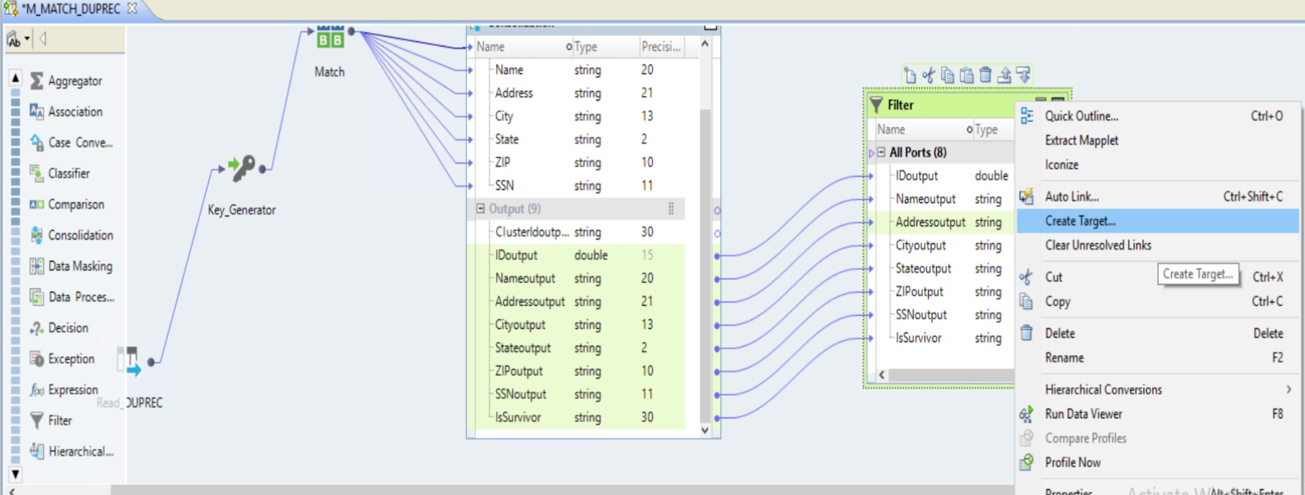
Step 8: TARGET
A . CREATE TARGET

Slide 81
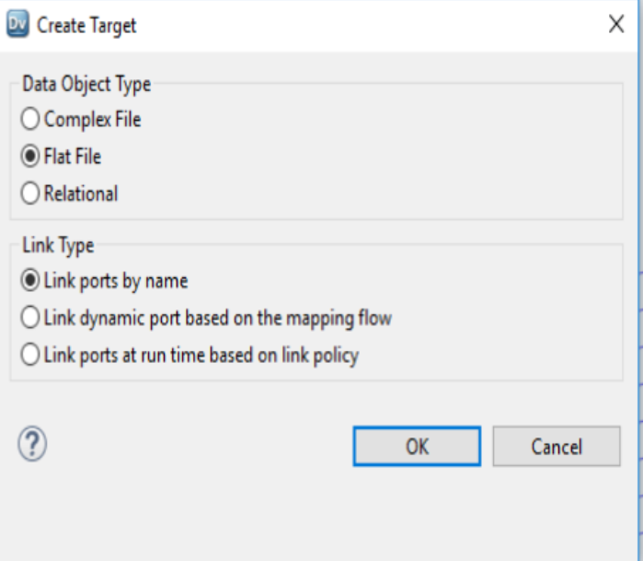
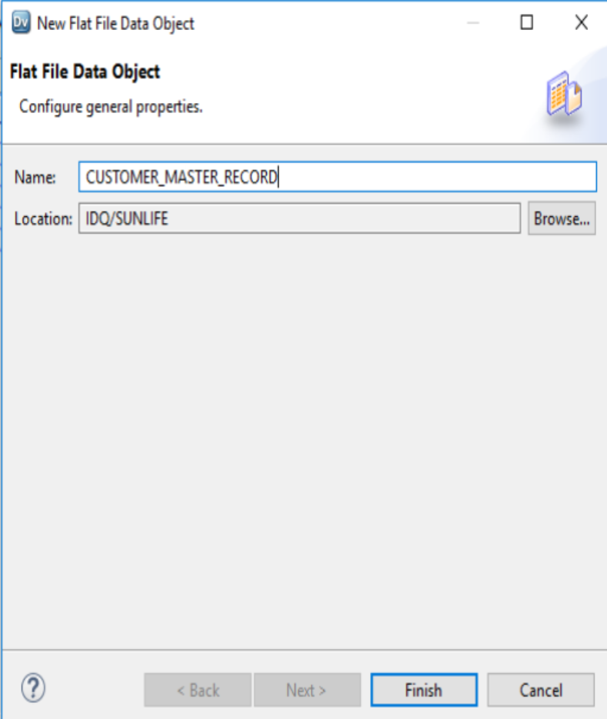
Step 8: TARGET
A . CREATE TARGET

Slide 82
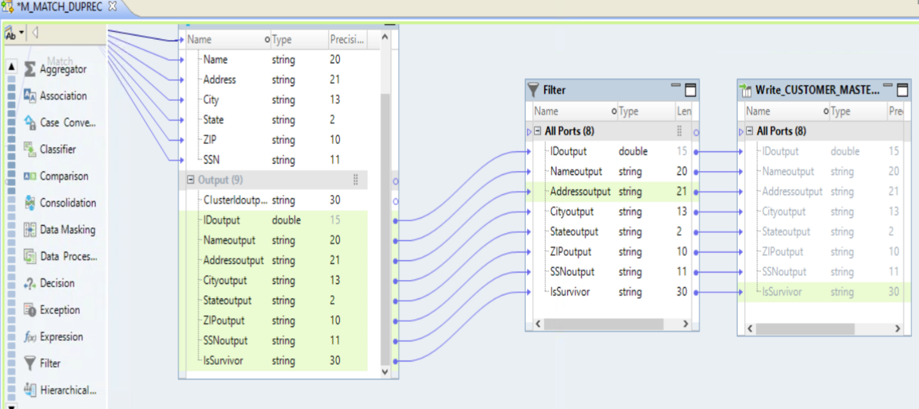
Step 8: TARGET
A . CREATE TARGET

Slide 83
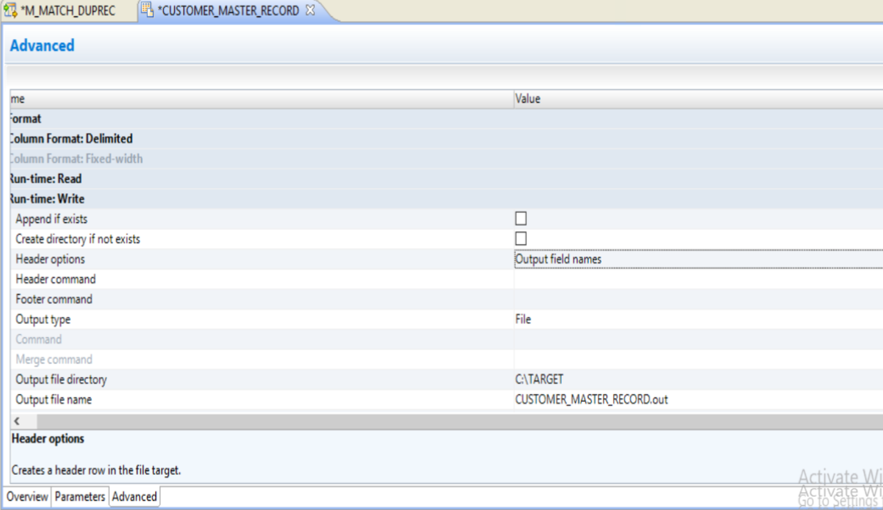
Step 8: TARGET
A . CONFIGURE TARGET WRITE RUNTIME PROPERTIES
A . OPEN TARGET ➔ ADVANCED ➔ WRITE RUN TIME PROPERITES ➔ CTRL + S ➔ SAVE CHANGES

Slide 84
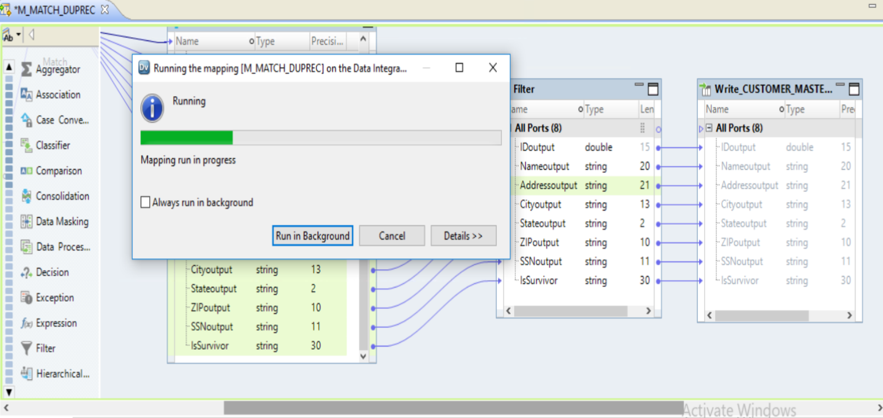
Step 8: RUN mAPPING

